Slide 1
CustomCastle A HOUSE RENTAL MANAGEMENT SYSTEM
Prepared By.
Subhakanta Roul(1701230053)
Silka Jasmin Parida(1701230098)
Ankita Moharana(1701230040)
Saumya Ranjan Mallik(1821230054)
Guided By.
Prof. S. Abinash
(HOD, Department of CSE)

Slide 2
Table Of Contents
Introduction
Project Objectives
Tools and Technologies
Flow of Control
Expected Outcomes
Feasibility study
Functional Requirements
Nonfunctional Requirements
Software Requirement Specification (SRS)
Data flow diagrams (level 0 , level 1 and level 2)
Use case diagram
Class diagram
Sequence Diagram
Structure Chart
Usefulness
Limitations

Slide 3
Introduction
This is an online rental management portal that helps in managing various rental properties and their operations.
This system will make easy to find the location of rooms/flats/houses, select number of rooms and other features by the Tenant.
This system will also make easy to update the details about the property like location, pictures, rent and facilities by Owner.

Slide 4
Project Objectives
Study of currently available open source applications developed in other countries.
Analysis the applications and try to modify them according to Indian environment.
Try to develop an efficient website that will be helpful for not only tenants but also landlords.
System development will be done according to the requirement of both tenants and landlords.

Slide 5


Tools And Technologies Used
Server side
Client side
Tools
Text Editor (VS code, Sublime Text)
Browser (Google Chrome)
Version Control Tool (Git)
XAMPP (local server)
MySQL 10.4
(php MyAdmin)
PHP 7.4
HTML 5
CSS 3
Bootstrap 4.0
JavaScript

Slide 6
Flow Of Control
Register/login user
Tenant
Owner
Search for property
Post property
Choose feasible property
Conversion to Deal

Slide 7
Expected Outcomes
This is a service which will connect tenants to Landlords and vice-versa.
It will save the physical hard work and invaluable time to find room/flat.
This system will make easy to find house for tenant and upload the location and other information by landlord.

Slide 8
Feasibility study:
The feasibility study is the preliminary study that determines whether a proposed system project is financially, technically and operationally feasible or not.
The system is operationally feasible as it provides accurate, active and secure service.
It is technically efficient so it can be concluded that the system is technically feasible.
It is economically feasible as it reduces the cost of the material used.
The system is free from any legal and contractual risks.

Slide 9
Functional Requirements:
This is a necessary task, action or activity that was accomplished. The proposed system is able to :
Allow administrator to add a house, tenants details.
Allow the administrator to delete houses, tenant details.
Allow the administrator to search data in the database.
Allow the administrator to edit data in the database.
Allow the owner to add, modify and remove on property database.
Allow the tenant to search, view, book and cancel the properties.

Slide 10
Actor | Function
Owner | Advertise the house Add, remove, modify info of the house
Tenant | Search the house Select the house they wants Register to rent the house
Administrator | Edit data in the database Delete data in the database Update data in the database Delete tenant and renters (if required)

Slide 11
Nonfunctional Requirement :
Security requirements
The system shall be intuitively usable.
Software quality attributes
Business rules(security issues)

Slide 12
Software Requirement Specification
R.1- Register
Description: In order to enter to the application, the user need to register himself/herself to the system. The registration process includes two choices.
R.1.1- Register as owner
Input:
Name
Phone No.
Address
Email Id
Password
Confirm Password
Output:
Registered Successfully
Error*

Slide 13
R.1.2- Register as Tenant
Input:
Name
Phone No.
Email Id
Password
Confirm Password
Output:
Registered Successfully
Error*

Slide 14
R.2 – Sign In/Login
Description: After Sign In/login registered users can access their data stored in the system database .
R.2.1 - Sign in as Owner
Input:
Email Id
Password
R.2.2 – Sign in as Tenant
Input:
Email Id
Password

Slide 15
R.3 – Search Property
Description: The following function provides an option to the tenant to search for his/her desired property.
Input: Location
Output: Search results from system database.
R.4 – Post Property
Description: This function provides the option to the user to post his property for rent.
Input:
Property Type
Address
Price
BHK
Type of Tenant (Bachelor/Family)
Photos of Property

Slide 16
Output:
Property posted successfully.
Error*
R.5 – Owner Dashboard
Description: This function provides tenant details as well as house details to the owner where he/she can manage and update the pay status of tenant.
R.6 – Tenant Dashboard
Description: This function provides house and owner details to tenant, where as tenant have no permission to edit anything.
Error*:
Check your connection.
Invalid Email.
Invalid Password.

Slide 17
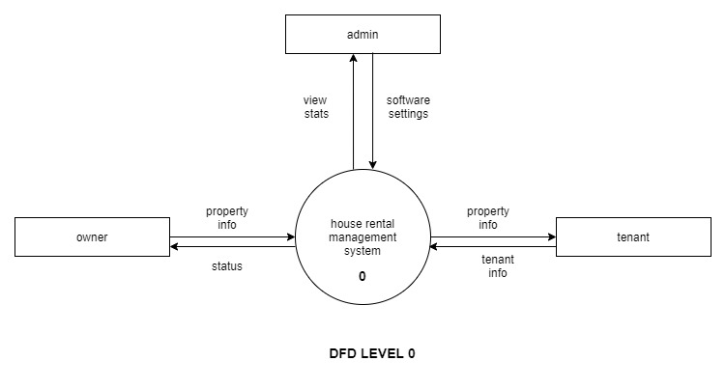
Data Flow Diagram (level 0)

Slide 18
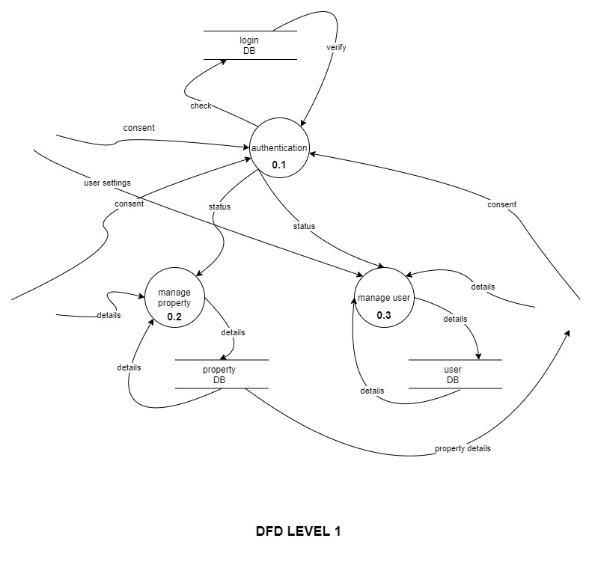
Data Flow Diagram (level 1)

Slide 19
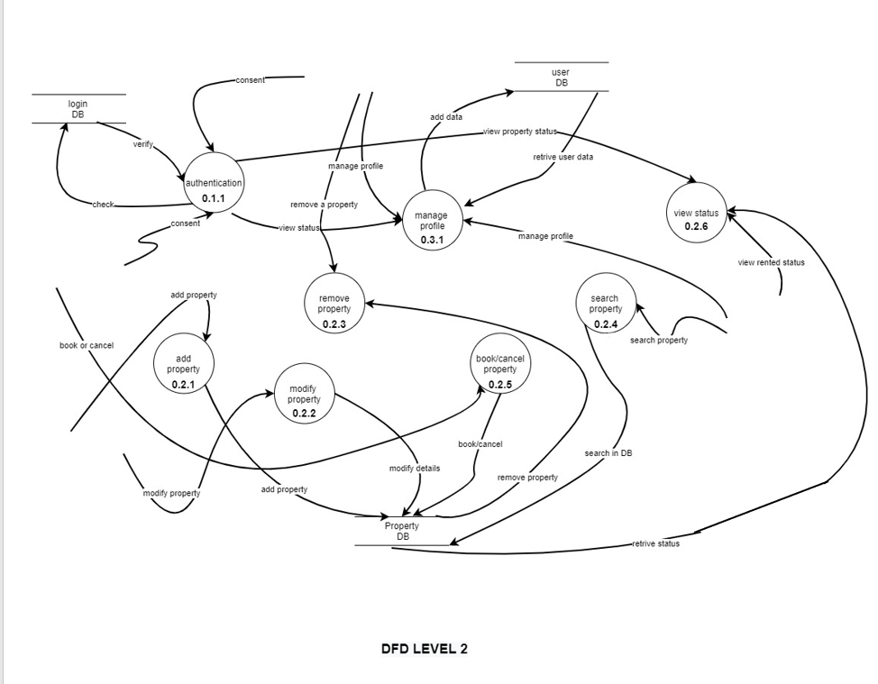
Data Flow Diagram (level 2)

Slide 20
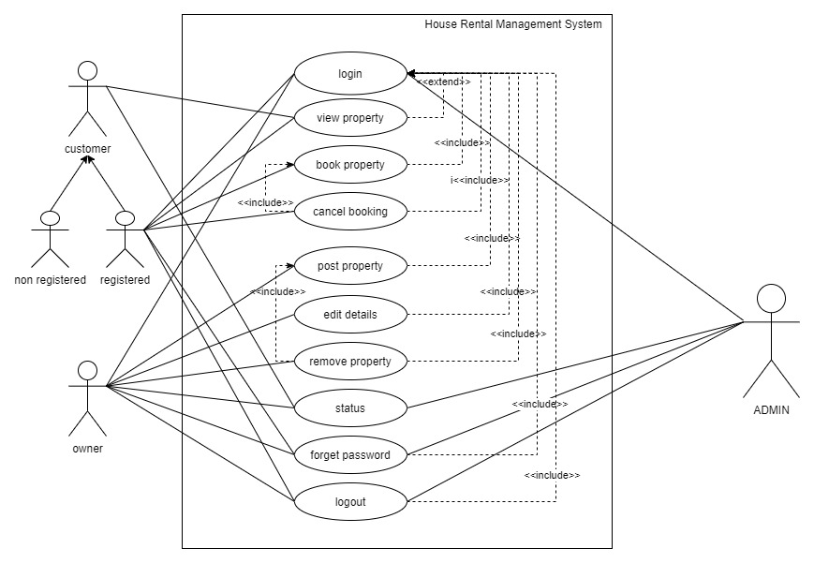
Use Case Diagram

Slide 21
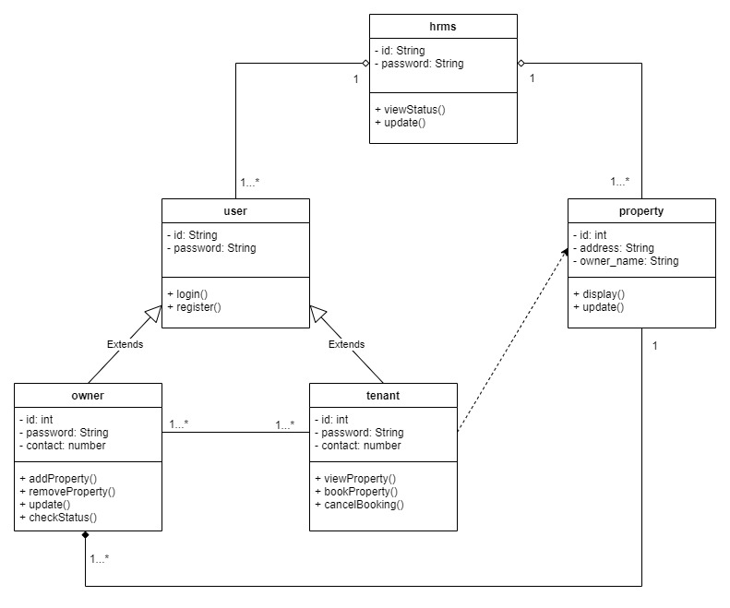
Class Diagram

Slide 22
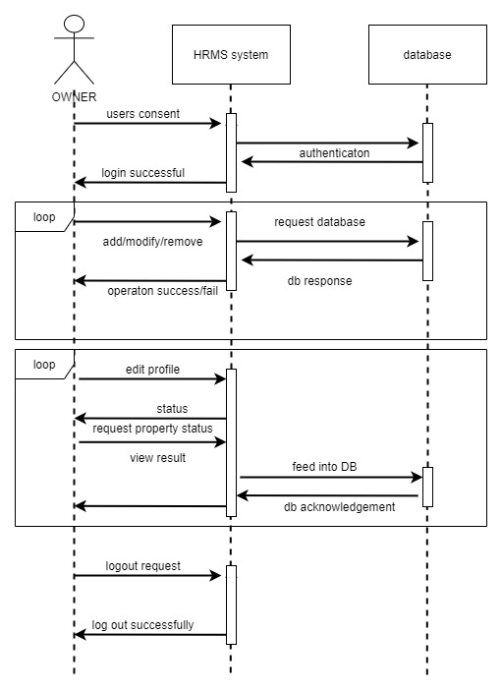
Sequence Diagram(Owner)

Slide 23
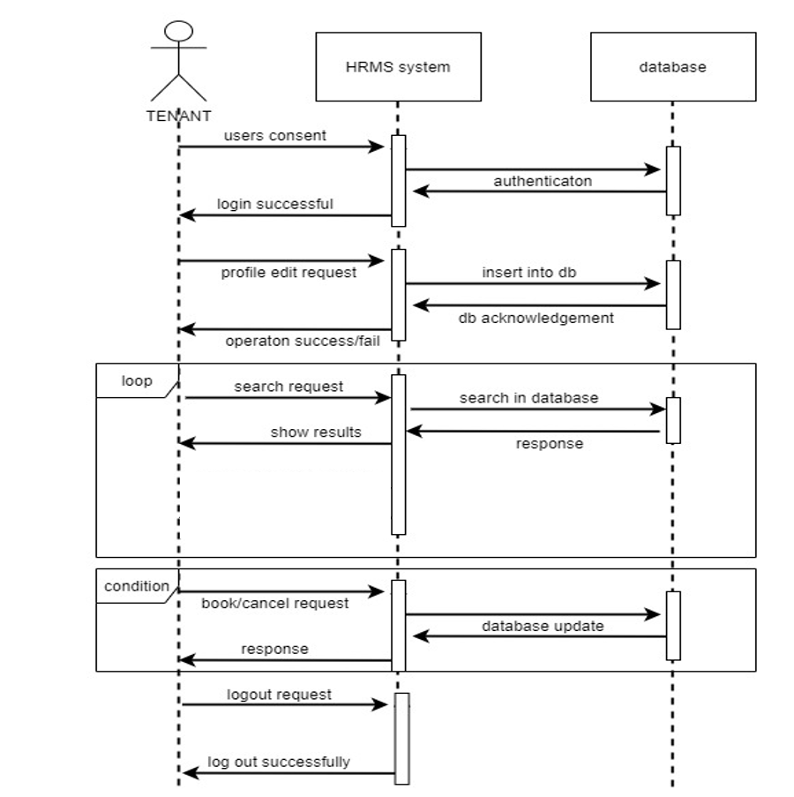
Sequence Diagram(Tenant)

Slide 24
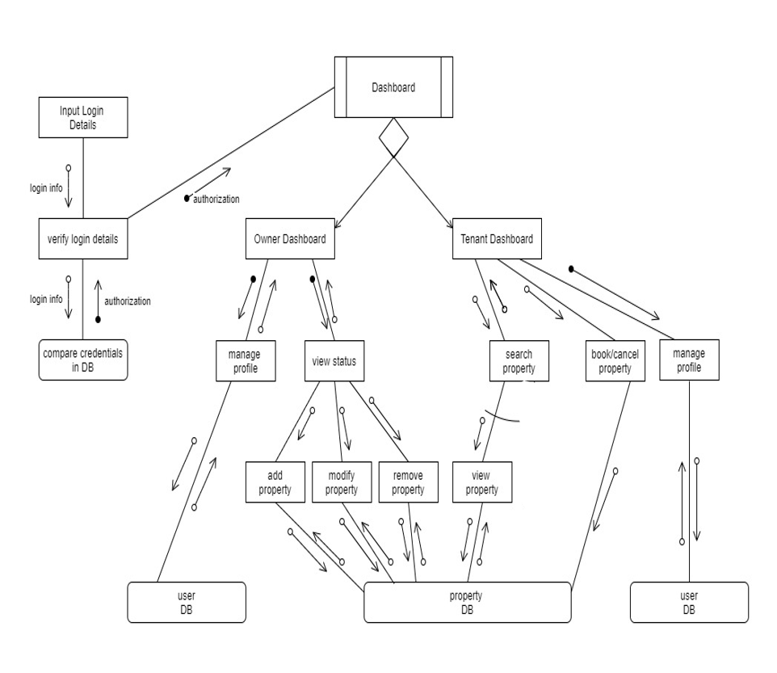
Structure Chart

Slide 25
Usefulness
This system will save both time and resources.
This will increase the efficiency of current rental system.
It will provide all registered locations to tenant and multiple tenants to the landlord.
Quick deal.
Direct communication between tenant and owner.

Slide 26
Limitations
Difficult to trace the past records of a tenants if a owner asks criminal record verification before renting.
Difficult to find out the proper location as no map has been added in this website.

Slide 27
View Web App

Slide 28
Bibliography
http://www.slideshare.net/jeanet10/home-rental-management-system
http://www.icodeguru.com/design/Enterprise-Architect/umldiagrams.htm
https://www.w3schools.com/php/php_ref_mysqli.asp
https://www.youtube.com/playlist?list=PLwGdqUZWnOp1U4kemcU_vF9KQuHXlNxkb
https://myengineeringprojects.in/engineering-project/online-rental-property-management-system/

Slide 29
Thank You
Guided By:
Prof. S. Abinash
(HOD, Department of CSE)
Prepared By:
Subhakanta Roul(1701230053)
Silka Jasmin Parida(1701230098)
Ankita Moharana(1701230040)
Saumya Ranjan Mallik(1821230054)

